Slide 1

Cheyenne Quann
07/13/2022
Beijing: An Expansion Opportunity?

Slide 2
Sotheby’s International Realty
The fifth best real estate agency in the world.
This real estate company is a luxury real estate brand that was founded in 1976. In 2004 it formed a strategic alliance with the company Realogy, which allowed the company to offer franchise opportunities to various brokerages.
Recently the company has expanded its presence globally and can now be found in countries such as Thailand and the Philippines in Southeast Asia.
With my help they’ll be able to expand into the capital of mainland China, Beijing.

Slide 3
Problem and Data
Business problem: How can we predict where the highest priced listings will present themselves as to increase our monthly revenue when we expand into China?
Acquired data about the Housing market in Beijing.
Including but not limited to:
Housing coordinates, community average income, home prices

Slide 4
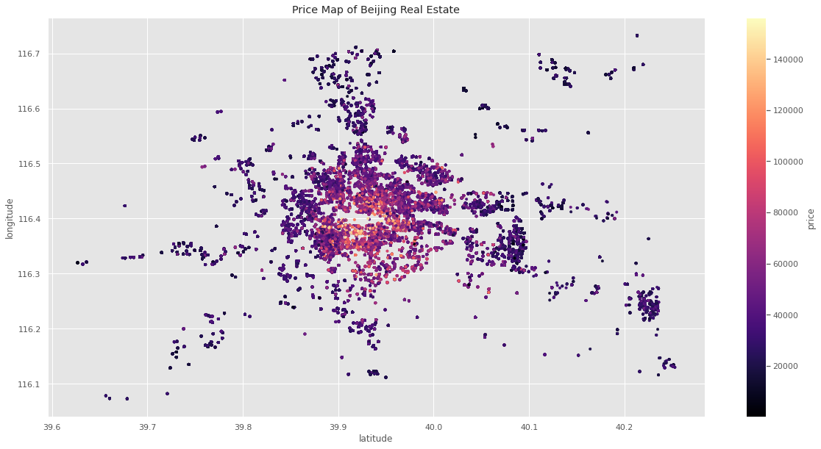

Slide 5
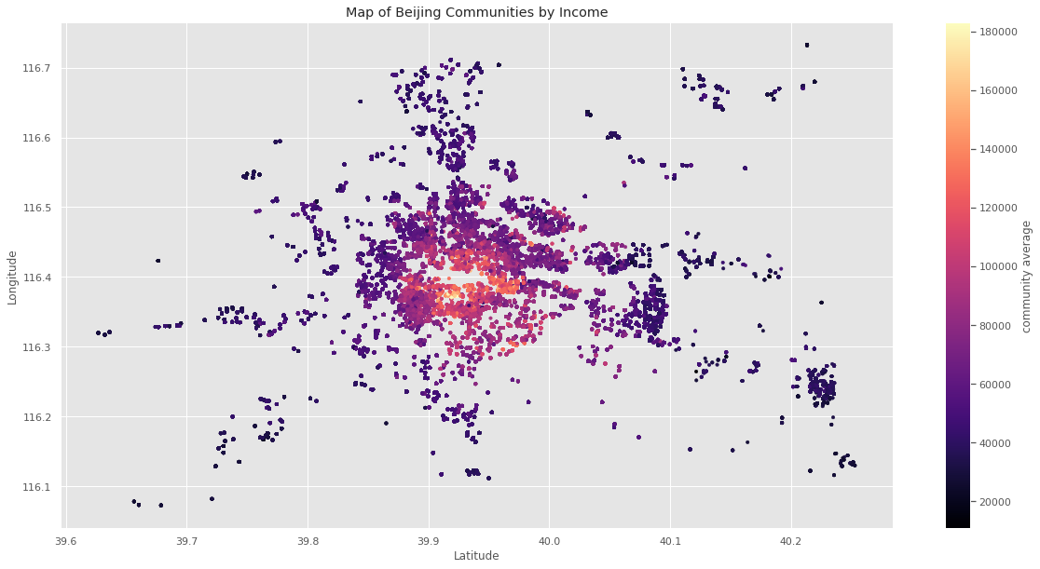

Slide 6
Model Strengths
My model was able to predict the price of homes that will come to the market in Beijing within $14,500.
For Sotheby’s, this is an affordable margin of error and we’ll be able to go into negotiations with a ballpark number we can be confident in.

Slide 7
Model Limitations and Next Step
I don't have a way of knowing if the people that reside in the brightly colored center area are interested in selling.
Given the density of wealth it is possible the families have owned these properties for generations.
My next steps would be to canvas the areas and find out just what kind of communities they are and how attached to the land are the people in the communities

Slide 8
Recommendations
Based on my findings, I believe any agency that wants to up their revenue and holdings should invest their time and energy into acquiring clients and properties from these neighborhoods in the center of my plot.
My plot has visualized that these homes do not exceed $180k even in the most expensive neighborhood
This venture will not only expand Sotheby’s influence but it will so at value prices

Slide 9
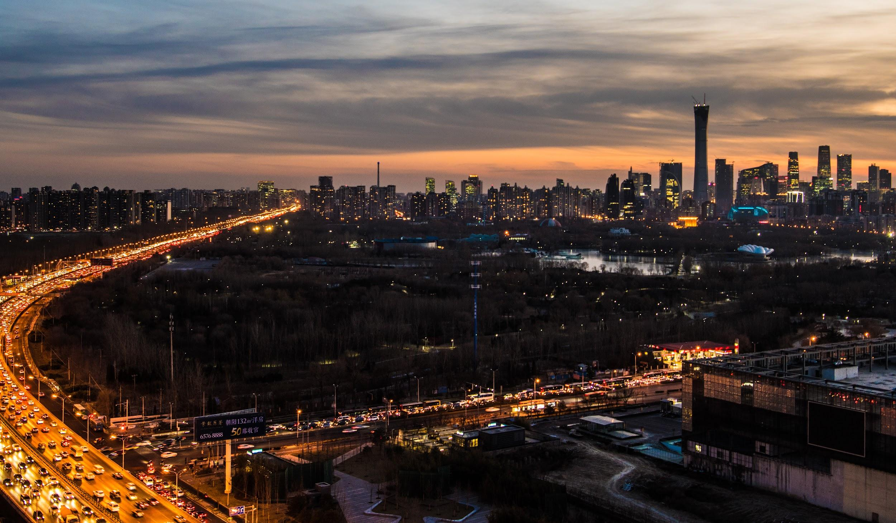
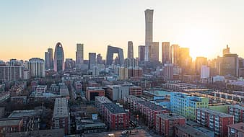
For any additional questions, please contact Cheyenne.quann@gmail.com
Thank you

